Slide 1

Create a LiveCode Cloud Server in
6 Steps in 60 Minutes
Step 1 - Setting up a web server with revIgniter & LiveCode
Step 2 - Understanding Control + Model + View development
Step 3 - Designing the 2 Views for the Web and App
Step 4 - Creating a data Model
Step 5 - Coding the Controller and Web View
Step 6 - REST API and mobile Apps

Slide 2
Create a LiveCode Cloud Server in
6 Steps in 60 Minutes
The slides and all the code and support files are located on a public Google drive and are open source and you are free to learn and reuse in your own project. You will see both the slides and a zip file. The files have been also uploaded in the app folder:
https://drive.google.com/drive/folders/0B8B_tWKHZdTLfmlSdVZhUlFSQzNGYWhFcVVVTnZNUGk5TVFzaUxTZTFtcDZ4RWpMZW1TdE0

Slide 3
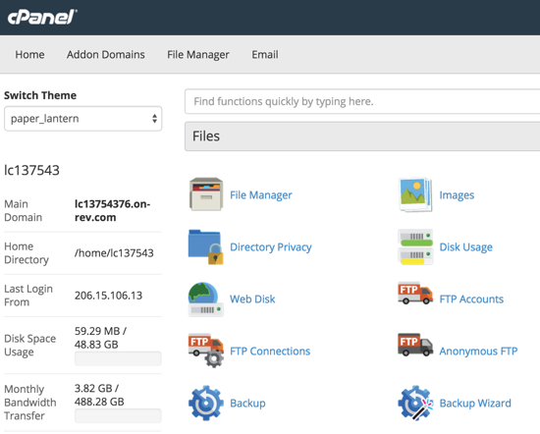
#1 Setting up a web server with revIgniter & LiveCode
After you log into your server, you will see the cPanel user interface.
cPanel is a control panel available on the LiveCode hosting accounts and servers. It lets you easily manage many aspects of your account, including the files, applications, and email hosted on your account.
Application-based support for Files, Databases [MySQL, PostgreSQL], Domains, Emails, Metrics, Security and more.
We suggest you explore and learn more...Just be careful with the settings.

Slide 4
#1 Setting up a web server with revIgniter & LiveCode
There are 3 areas we need to be aware first:
Main Domain: This is the domain assigned to your on-rev hosting account. You can get you own domain URL like www.yourwebsite.com, but this will always be available your core URL.
File Manager: Here is where you can add sub directories and organize you files, just like you would on your PC.
FTP Accounts: To link your PC with your web server, you will need to setup and link to an FTP account on your server.

Slide 5
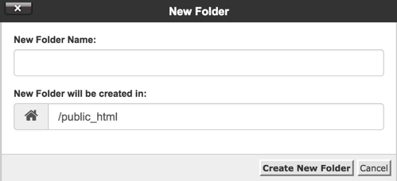
#1 Setting up a web server with revIgniter & LiveCode
Create a New Folder
The first step in creating a new website is to create a new folder [directory] to hold the website in. I do NOT recommend putting any site into your root or public_html folder.
Click file directory, select public_html and click "+ Folder". The New Folder box will appear with a place for you to enter the name. Make sure that the new folder will be created in the "/public_html" folder so that you can be assured public access.
Your URL: [main domain name].on-rev.com/[new folder]

Slide 6

#1 Setting up a web server with revIgniter & LiveCode
FileZilla is one of the best open source cross platform FTP applications on the market today.
These are some features of FileZilla.:
Transfer files in FTP, SFTP, encrypted FTP such as FTPS and SFTP
Support IPv6 which is the latest version of internet protocol
Available in 47 languages worldwide
Supports resume which means the file transfer process can be paused and continued
Bookmarks for easy access to most frequent use
Drag & Drop
FREE
FileZilla
https://filezilla-project.org/

Slide 7

#1 Setting up a web server with revIgniter & LiveCode
revIgniter empowers you to build websites in a fraction of time compared to writing LiveCode code from scratch by providing a large number of code libraries addressing frequently needed tasks, as well as a straightforward interface and consequential pattern to access these libraries.
The first step is to install revIgniter, then read all the topics in the Introduction section of the user guide. Next, read each of the General Topics pages in order. Each topic builds on the previous one, and includes code examples that you are encouraged to try. Once you understand the basics, explore the Library and Helper Reference pages to learn to utilize the native libraries and helper files.

Slide 8
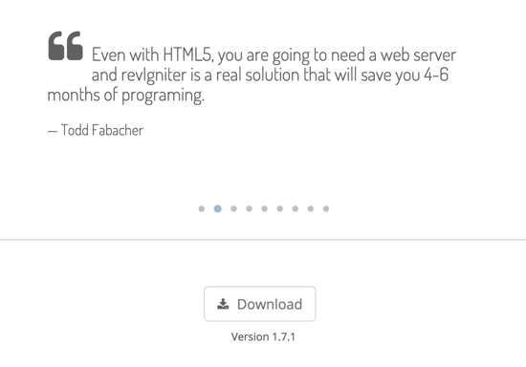
#1 Setting up a web server with revIgniter & LiveCode
To download revIgniter, you can find the download button on the homepage or go directly to the download link:
http://revigniter.com/download
Once you download the zip file, expand it where you wish to keep the website locally and can be backed up.
The first step is to install revIgniter, then next read all the topics in the Introduction section of the user guide.

Slide 9
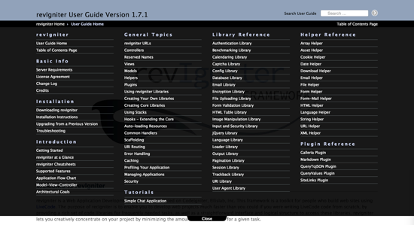
#1 Setting up a web server with revIgniter & LiveCode
Click the User Guide button or directly to the link: http://revigniter.com/userGuide
revIgniter empowers you to build websites in a fraction of time compared to writing LiveCode code from scratch by providing a large number of code libraries addressing frequently needed tasks, as well as a straightforward interface.
Read each of the General Topics pages in order. Each topic builds on the previous one, and includes code examples that you are encouraged to try. Once you understand the basics, explore the Library and Helper Reference pages to learn to utilize the native libraries and helper files.

Slide 10

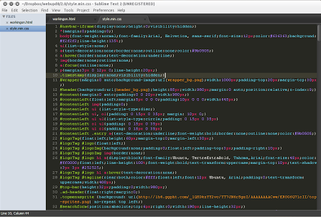
#1 Setting up a web server with revIgniter & LiveCode
You will need an editor for the LiveCode server scripts. You can edit directly online, but I do not recommend it. A FREE option is Atom.
URL: https://atom.io/
Server ^ Bundle Files: https://atom.io/packages/language-livecode
revIgniter:
https://atom.io/themes/revigniter-syntax
revIgniter has a TextMate bundle that work with Atom. which will color code and provide a template for your LiveCode server script and also LC 8 Builder
Download Atom

Slide 11
#1 Setting up a web server with revIgniter & LiveCode
Download and install the revIgniter TextMate Bundle: http://revigniter.com/downloadtmb
Download the file and unzip it
Find the directory on your computer..On the Mac, in Finder...under Go Menu, click the "Go to Folder…" Type in: ~/Library/Application Support/textmate/Managed/Bundles/
Copy the revIgniter_1_6_.tmbundle and iRev.tmbundle files to the folder.
We strongly suggest you read the README.md that comes with the bundle to lern more options.
Start up TextMate again, click the Bundles in the menu, and you should see revIgniter in the list of other bundles included.

Slide 12
#1 Setting up a web server with revIgniter & LiveCode
With revIgniter, you start setting up your website in the config.lc file. You will find it in the following path:
revIgniter
system
application
config
config.lc
Double click it on the file list on the right and the code will appear on the left. The first section is labeled Base Site URL and that is where we will start.
##
#--------------------------------------------------------------------------
# Base Site URL
#--------------------------------------------------------------------------
#
# URL to your revIgniter root. Typically this will be your base URL,
# WITH a trailing slash:
#
# http://example.com/
#
# Set this to "" if you use secure URLs (https) along with normal
# URLs (http). If this is "" then revIgniter will guess the protocol,
# domain and path to your installation.
#
##
put "http://example.com/" into gConfig["baseUrl"]
* MUST end with a slash "/"

Slide 13
#2 Understanding Control + Model + View development
Control
The MVC architectural pattern separates the representation of data from the logic of the application.
The View is what the visitors of the web or LiveCode application see.
The Controller is responsible for handling the incoming requests, validating input and showing the right view.
The Model is responsible for accessing the database or executing other operations.
Model
View

Slide 14
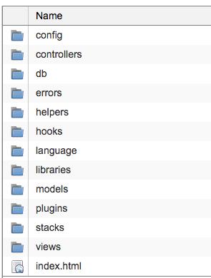
#2 Understanding Control + Model + View development
There is an old question - What comes first the chicken or the egg? Well in this in designing cloud based web app, it is the chicken. We are doing the results first.
I recommend that you follow these steps:
Design the User Interface View
Create an Array Data Model
Code the Control logic between the model and the view.
Control
Model
View

Slide 15
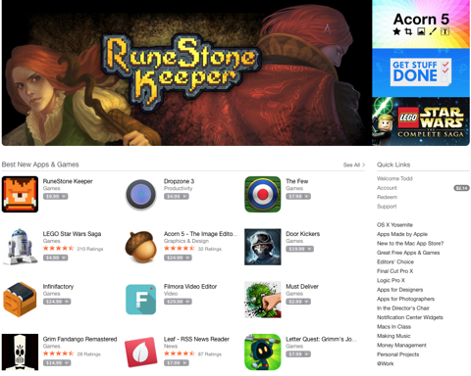
#2 Understanding Control + Model + View development
App Store UI
Our goal is to design an App similar to Apple's App Store. As you can see the User Interface [View] is broken into three sections:
1. Slider
2. Products
3. Category
1
2
3

Slide 16
#2 Understanding Control + Model + View development
index.lc HTML [View]
In the views folder create let’s create index.lc. Copy over the HTML on the right and save the file.
1. Slider - The slider Images will be built in this section.
2. Products - We will need to be a row based grid that list the apps for download and sale..
3. Category - This is a list of the App categories.
<html>
<p id="slider">1. Slider</p>
<p id="products">2. Products</p>
<p id="categories">3. Categories</p>
</html>
1
2
3

Slide 17
#2 Understanding Control + Model + View development
All road lead to a Controller
The job of the Controller is to be the traffic cop between the Model [Data] and the View [output.] Because of that, nothing goes in or out of the web server without going through the controller.
1. All LiveCode server script MUST start with <?lc to tell the system that the following code is script.
2. All the the command names MUST be put into the global gControllerHandlers variable as a comma separated text
3. Just like LiveCode, the script goes here.
1
<?lc
# PUT YOUR METHOD NAMES INTO THE GLOBAL gControllerHandlers AS A COMMA SEPARATED LIST
put "homeHTML" into gControllerHandlers
#insert data into home html View
command homeHTML
get rigLoadView("index")
end homeHTML
--| END OF index.lc
--| Location:./system/application/controllers/index.lc
----------------------------------------------------------------------
2
3

Slide 18
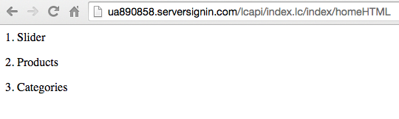
#2 Understanding Control + Model + View development
CONGRADULATIONS!
You have created your first web page. Take a look at the URL. You will see the logical path:
[Your URL]/[Your Folder under the root]/[index.lc]/[Index- controller]/[homeHTML - command called]
1
2
3
4
5

Slide 19
#2 Understanding Control + Model + View development
Slide Model [models/sliderModel.lc]
Next up is the model. This where you query the database or get from other web services. Today we are just going to create a simple array data model.
1. The model MUST always start with the gBASEPATH code to stop hackers.
2. Next, should be the code that builds the array to return to the controller. Remember, the model only gets the data, it does not know what you plan on doing with it.
3. Just like LiveCode, you return the array.
<?rev
put gBASEPATH into gBASEPATH
if gBASEPATH is "gBASEPATH" then
put "No direct script access allowed."
exit to top
end if
#get slider data from database , then convert to json
function getSliderData
--Load an image fo rthe Slider
put "assets/images/slide1.jpg" into tSlider[1]["slideImgURL"]
put "67541" into tSlider[1]["sliderID"]
--Return the Slider Data as an Array
return tSliderA
end getSliderData
1
2
3

Slide 20
#2 Understanding Control + Model + View development
All road lead to a Controller [index.lc]
The job of the Controller is to be the traffic cop between the Model [Data] and the View [output.] Because of that, nothing goes in or out of the web server without going through the controller.
1. To use a model, you must load it first with the rigLoadModel function.
2. All the the command names MUST be put into the global gControllerHandlers variable as a comma separated text
3. Just like LiveCode, the script goes here.
command homeHTML
rigLoadModel "sliderModel"
# load slider images and data
put getSliderData() into tSliderArray
# all data MUST be put in gData Array
put tSliderArray into gData["slider"]
get rigLoadView("index")
end homeHTML
1
2
3

Slide 21
#2 Understanding Control + Model + View development
Update the View with the Array
Now that we have the data array, we need to update our view:
1. This an example of putting script code in the View. To execute LC script, just wrap it with <? ... ?>. Then just return your value.
2. revIgniter framework hold several global variables in an array. gConfig[“baseURL”] is one of them.
3. Now that we need to add the image path and name. We get the image info from the array and place it into the HTML.
<html>
<p id="slider"> <? return 1+0 & ". Slider" ?>
<img src="[[gConfig["baseUrl"]]][[gData["slider"][1]["slideImgURL"]]]"/>
</p>
<p id="products">2. Products</p>
<p id="categories">3. Categories</p>
</html>
1
2
3

Slide 22
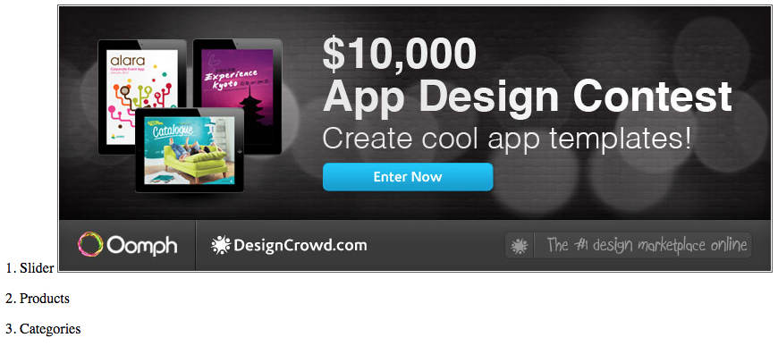
#2 Understanding Control + Model + View development
CONGRADULATIONS!
You have created your 2 web page, but this time it is built on data and logic

Slide 23
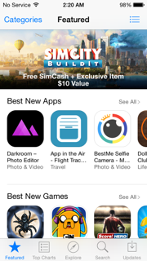
#3 Designing the 2 Views for the Web and App
#Tip - Design Your View First
Now that we have a basic understanding of revIgniter and how to use LiveCode in creating web servers. I want to focus on a major resign question. How to develop cloud based Apps and web pages.
My advice to you is to focus on the View, Complete you Wireframe, then do a complete mockup in LiveCode and HTML before you start to design the model and controller.
Always remember that you need to know the design before you start conscruction.

Slide 24
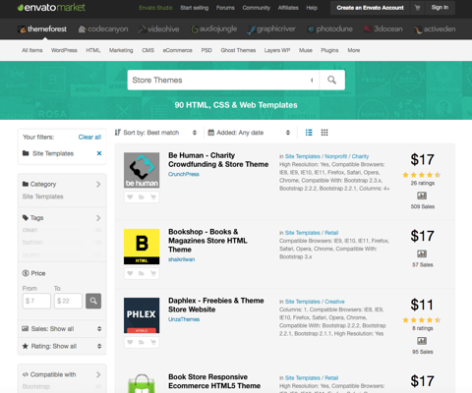
#3 Designing the 2 Views for the Web and App
HTML Templates
Many people try and design their own web templates, but my suggestion is to find an existing HTML page template or even a complete website and then edit the design from there.
Unless you have the design resources, time, money and desire -
JUST BUY IT!!

Slide 25
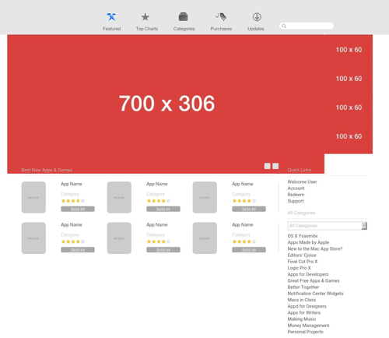
#3 Designing the 2 Views for the Web and App
Our goal is to design an App similar to Apple's App Store. As you can see the User Interface [View] is broken into three sections:
1. Slider
2. Products
3. Category
You will the AppStoreTemplate.HTML and the AppStoreTemplate.lc files in the files folder. Take a look at them. The HTML is there for your reference. I have converted it to the LiveCode format for you.
1
3
2

Slide 26
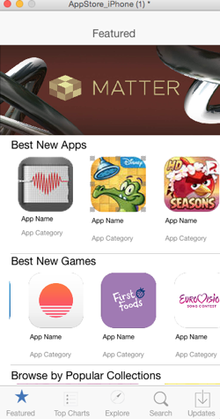
#3 Designing the 2 Views for the Web and App
The AppStore_iPhone.livecode project file is also included. It is a simple demo app of the iPhone's App Store in LiveCode. You will notice our three areas again:
1. Slider
2. Products
3. Category [on Another Card]
You will the AppStoreTemplate.HTML and the AppStoreTemplate.lc files in the files folder. Take a look at them. The HTML is there for your reference. I have converted it to the LiveCode format for you.
1
2
3

Slide 27
#4 Creating a Data Model
1. AppStore["slider"]
[#]["slideID"]
[#]["slideImgURL"]
[#]["thumbImgURL"]
2. AppStore["products"]
[#]["group"]
[#]["appid"]
[#]["appimage"]
[#]["appname"]
[#]["appcategory"]
3. AppStore["category"]
[#]["catid"]
[#]["catName"]
What is a Data Model? It is an array structure which usually matches your view. The job of the controller is to call the different model functions to create an array to be used in the view.
We have three areas of our view, so we will create a matching model array. We will also create 3 models in revIgniter to product the data we need.

Slide 28
#4 Creating a Data Model
Model Header
Security is a constant concern with anything on the internet. We will be covering a list of security issues, tips and tricks later. For today, the main way to protect your data scripts is to start each model with this header so there is no direct access to the file from the outside.
<?lc
put gBASEPATH into gBASEPATH
if gBASEPATH is "gBASEPATH" then
put "No direct script access allowed."
exit to top
end if

Slide 29
#4 Creating a Data Model
models/slidermodel.lc
We build the data array of the content slider. At first, we are simply constructing an array manually to demonstrate the functionality.
Usually you would read the data from a database or an external data source and then convert that into your data model array.
function getSlider pGroup
put "1" into tSlider[1]["slideID"]
put "slide1.jpg" into tSlider[1]["slideImgURL"]
put "thumb1.jpg" into tSlider[1]["thumbImgURL"]
put "2" into tSlider[1]["slideID"]
put "slide2.jpg" into tSlider[2]["slideImgURL"]
put "thumb2.jpg" into tSlider[2]["thumbImgURL"]
…
put "5" into tSlider[1]["slideID"]
put "slide5.jpg" into tSlider[5]["slideImgURL"]
put "thumb5.jpg" into tSlider[5]["thumbImgURL"]
return tSlider
end getSlider

Slide 30
#4 Creating a Data Model
models/productmodel.lc
Because we will call this model with a parameter eventually when we add in the database, we have included the parameter and return the array as it would normally do.
function getAppsByGroup pAppGroup
switch pAppGroup
case "featured"
put "03b1125b-3b83-11e5-bbe2-001e67b6630e" into tApp[1]["appid"]
put "Mind the Place" into tApp[1]["appName"]
put "1.png" into tApp[1]["appImage"]
put "Productivity" into tApp[1]["appCategory"]
...
break
case "games"
put "03b1125b-3b83-11e5-bbe2-001e67b6630e" into tApp[1]["appid"]
put "Minecraft" into tApp[1]["appName"]
put "7.png" into tApp[1]["appImage"]
put "Games" into tApp[1]["appCategory"]
...
break
End switch
return tApp
end getAppsByGroup

Slide 31
#4 Creating a Data Model
models/categorymodel.lc
Add the Categories into an array and return it. Remember that the trick of the trade it to first create a data model by hard coding an array like we did here.
It will save you weeks and weeks of headaches when crunch time comes to deliver your app.
function getAppCategories
put "03b1125b-3b83-11e5-bbe2-001e67b6630e" into tAppCategories[1]["catid"]
put "Productivity" into tAppCategories[1]["catName"]
put "0be31c28-3b83-11e5-bbe2-001e67b6630e" into tAppCategories[2]["catid"]
put "Reference" into tAppCategories[2]["catName"]
put "14d68f57-3b83-11e5-bbe2-001e67b6630e" into tAppCategories[3]["catid"]
put "Social Networking" into tAppCategories[3]["catName"]
…
put "f6b80d17-3b83-11e5-bbe2-001e67b6630e" into tAppCategories[19]["catid"]
put "Utilities" into tAppCategories[19]["catName"]
return tAppCategories
end getAppCategories

Slide 32
#5 Coding the Controller and Web View
controllers/index.lc
Now we finally start to wrap all of this together into a concept of a “cloud” server on the web. This is done with the code and logic of the controller.
1. Always load the models with the rigLoadModel function. it will tell revIgniter to load the functionality and make the script available. Here we are loading the 3 models we have created.
2. Now call our model function which will return to us the array.
3. Same with the App products, but here we only get one group at a time.
function buildAppHomeArray
#load the models
rigLoadModel "sliderModel"
rigLoadModel "productModel"
rigLoadModel "categoryModel"
--------------------------------------------
--Slider
# load slider images and data
put getSliderData("home") into tSliderArray
put tSliderArray into tHomePageA["slider"]
--------------------------------------------
--Products
# load Featured Products
put getAppsByGroup("featured") into tFeaturedA
put tFeaturedA into tHomePageA["products"]["featured"]
..Continue on next slide
1
2
3

Slide 33
#5 Coding the Controller and Web View
4. Get the next app product group. In this case it is “games”.
5. After the array is created, return the tHomePageA array.
# load Best Game Products
put getAppsByGroup("games") into tGamesA
put tFeaturedA into tHomePageA["products"]["games"]
--------------------------------------------
--Category
put getAppCategories() into tCategoriesArray
put tCategoriesArray into tHomePageA["categories"]
return tHomePageA
end buildAppHomeArray
4
5

Slide 34
#5 Coding the Controller and Web View
controllers/index.lc
homeAppStoreHTML is the actual public call to generate the HTML for our App Store.
1. We call the buildAppHomeArray to load load the array and do all of the work with the model. Our job here is to load it into the gData global array to be use in the view.
2. Call the rigLoadView which will find the “home” home.lc in the views folder.
command homeAppStoreHTML
--Get the Data from the buildAppHomeArray
--and simply add it to the global array gData
put buildAppHomeArray() into gData["slider"]
--Build the Home Page
get rigLoadView("home")
end homeAppStoreHTML
1
2

Slide 35
#6 REST API and mobile Apps
Now the App side… This will be different from our web view because the server can not control the view. It is an app that has already been created. We can only send the data array in the form of JSON. The the App [an external View] will need to have the logic to
Get the JSON from the server by using the cCloudURL URL.
Convert the JSON back into an Array.
Use the data to create a View, but this time for mobile apps.

Slide 36
#6 REST API and mobile Apps
controllers/index.lc
This time we need to get our Array data to the View. But this time it is a mobile LiveCode App, NOT HTML. The data format will be JSON. It is a text representation of the array and can be easily sent over the internet because it is text. We need to add getHomeData in out controller.
1. Include "easyjson.lc" to do the Array to JSON conversion
2. Get the array buildAppHomeArray() function.
3. Call the jsonFromArray() function to convert everything to JSON to return it to the app making the call.
command getHomeData
include "easyjson.lc"
--Get the Data from the buildAppHomeArray
--and simply add it to the global array gData
put buildAppHomeArray() into tHomeDataArray
#convert data entries array to json
put jsonFromArray (tHomeDataArray) into tJSON
--Return JSON to the caller
put tJSON
end getHomeData
1
2
3

Slide 37
#6 REST API and mobile Apps
controllers/index.lc
VERY VERY IMPORTANT
I can not tell you how many times people [myself included], forget to declare the function they wish to make public in the controller.
You need to list the function in the gControllerHandlers on the top of your controller.lc file.
If you do not, and you try to call the function, you will get back HTML with a “404 Page Not Found” error.
# PUT YOUR METHOD NAMES INTO THE GLOBAL gControllerHandlers AS A COMMA SEPARATED LIST put "homeAppStoreHTML, homeHTML, getHomeData" into gControllerHandlers

Slide 38
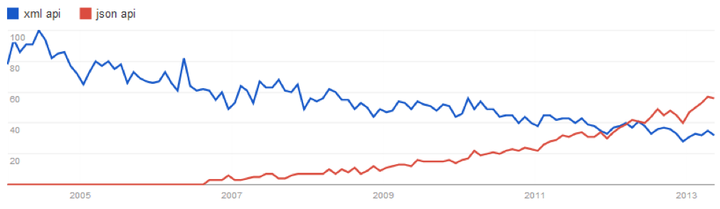
#6 REST API and mobile Apps
JSON is the primary data format for Cloud and web based services, overtaking XML several years ago. XML is still a viable data format, but because most tool have built in JSON reads and it is the native format for web browsers - JSON has become the winner.
To learn more go to:
JSON.ORG
Wikipedia
W3 Schools
LiveCode JSON libraries. We will be using Easy JSON:
Easy JSON
libJSON

Slide 39
#6 REST API and mobile Apps
cCloudURL
MOST IMPORTANT: you will need to know the URL address for your cloud.
The best option is to keep your cloud server as a stack custom property accessible everywhere in you app.
I suggest you set it on openStack and it will then be used in the functions to get the data. For several reasons, it is recommend to have one central function to access your cloud data.
If you find bugs or a better way to access the data, you only need to change that in one place
on openstack
set the fullscreenmode of this stack to "exactfit"
start using stack "easyJSON"
set the cCloudURL of this stack to "http://ua890858.serversignin.com/lcapi/index.lc/index/"
set the cFileURL of this stack to "http://ua890858.serversignin.com/lcapi/assets/images/"
end openstack
set the cCloudURL of this stack to "[Your cloud URL]"
set the cFileURL of this stack to "[Your Image files URL]"

Slide 40
#6 REST API and mobile Apps
getCloudData
First, in the Stack script, we finally start to wrap all of this together into a concept of a “cloud” server on the web. We create the getCloudData function to communicate with the cloud.
1. Always load the models with the rigLoadModel function. it will tell revIgniter to load the functionality and make the script available. Here we are loading the 3 models we have created.
2. Now call our model function which will return to us the array.
3. Same with the App products, but here we only get one group at a time.
function getCloudData pPostA, pAPICall
--build the URL
put the cCloudURL of this stack & pAPICall into tRestAPIurl
If pPostA is empty then
--No tArgList so just get the JSON
put URL(tRestAPIurl) into tResponce
else
--Build the argument list by looping the tArgList array
--**IMPORTANT**: the key in the array MUST match the
-- expected parameter on the array.
put empty into tArgList
repeat for each key tKey in pPostA
if tArgList is not empty then
put "&" after tArgList
end if
put tKey & "=" & urlEncode (pPostA[tKey]) after tArgList
end repeat
1
2
3

Slide 41
#6 REST API and mobile Apps
getCloudData
Now we finally start to wrap all of this together into a concept of a “cloud” server on the web. This is done with the code and logic of the controller.
1. Always load the models with the rigLoadModel function. it will tell revIgniter to load the functionality and make the script available. Here we are loading the 3 models we have created.
2. Now call our model function which will return to us the array.
3. Same with the App products, but here we only get one group at a time.
--Set the ArgList to the RESTAPI
post tArgList to URL tRestAPIurl
put it into tResponce
end if
--Convert the JSON Response Data to an Array
put empty into tResultArray
put arrayFromJson(tResponce) into tResultArray
--Return the Array
return tResultArray
end getCloudData
1
2
3

Slide 42
#6 REST API and mobile Apps
getCloudFile
Second, in the Stack script, we create the getCloudFile function to read and download media files from the internet. Livecode makes this easy:
1. Build the URL based on the given path to the location of the file. Usually it will not be the same full URL as your controller. It is off the root folder of your website.
2. It uses the URL function to read the file from the internet and puts it into the tFileBinary variable which is returned.
function getCloudFile pFileName
--build the URL
put the cFileURL of this stack & pFileName into tFileURL
put URL tFileURL into tFileBinary
--Return the Array
return tFileBinary
end getCloudFile
1
2

Slide 43
#6 REST API and mobile Apps
Now lets tie together our data from the controller/model
Get the JSON from the server by using the cCloudURL URL.
Convert the JSON back into an Array.
Use the data to create a View, but this time for mobile apps.

